Slide 1


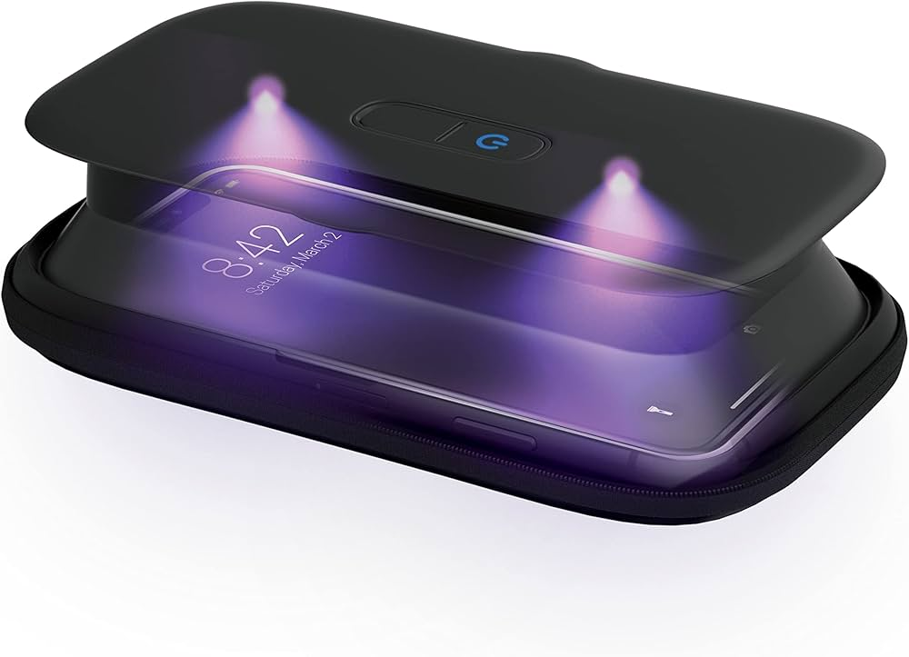
UV Sterilisation Box for Phones
Safety comes first

Slide 2
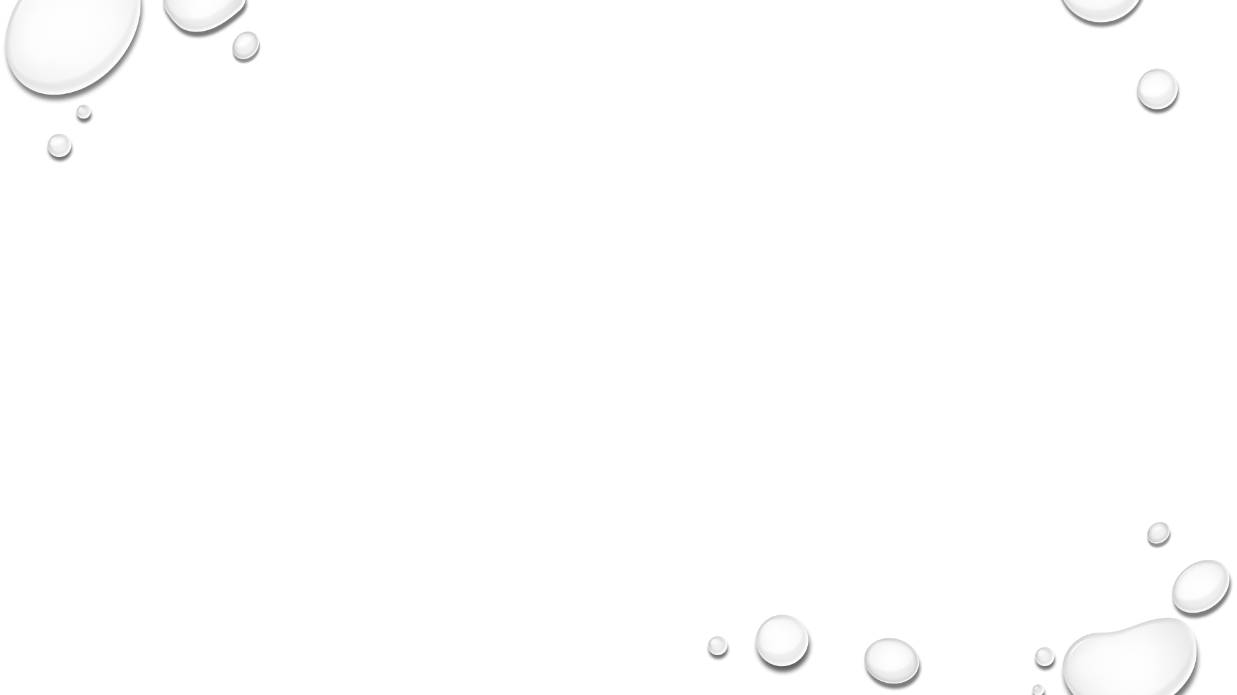
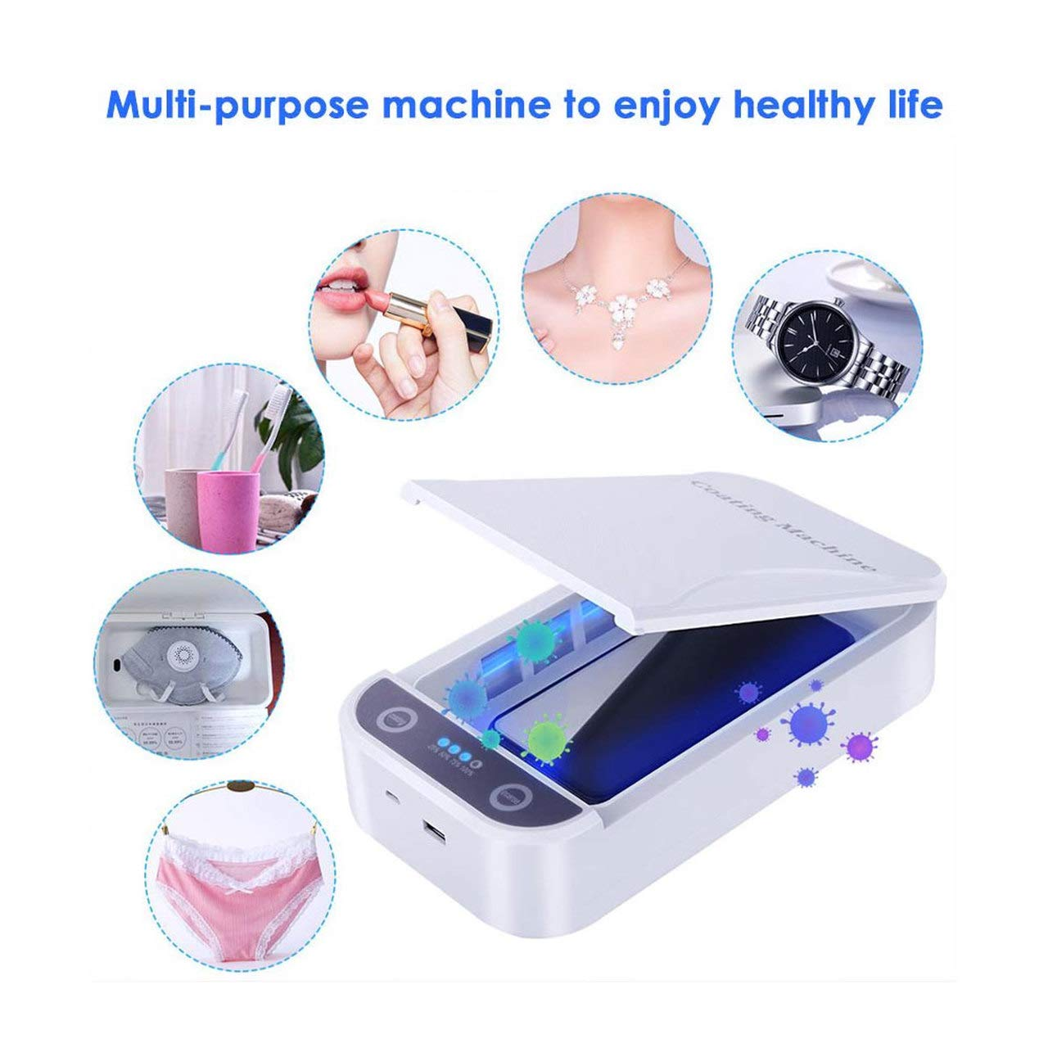
Introduction
Mobile phones carry many germs
Need for hygienic cleaning
UV technology used for sterilization

Slide 3
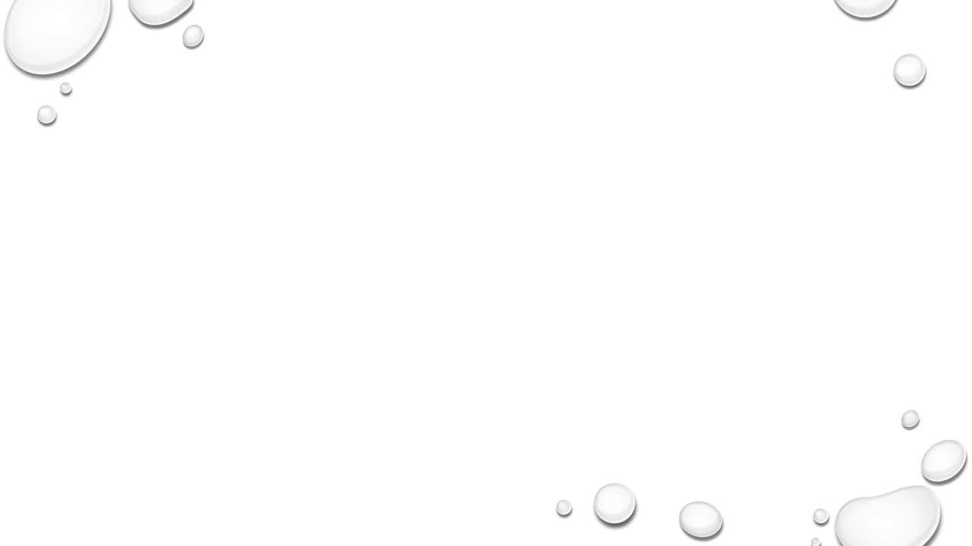
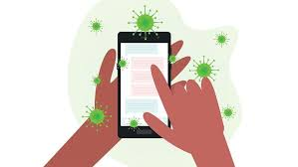
objectives
To design a UV-based sterilization system
To automate the sterilisation process
To reduce germs on phone surfaces

Slide 4
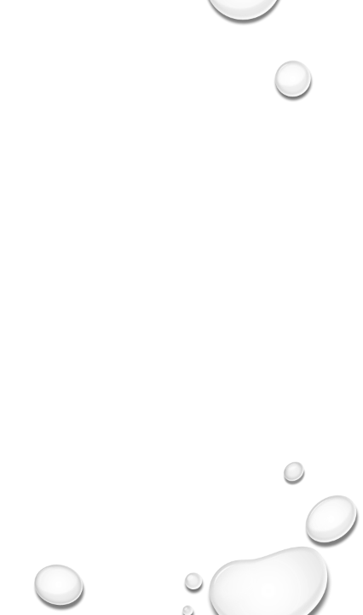
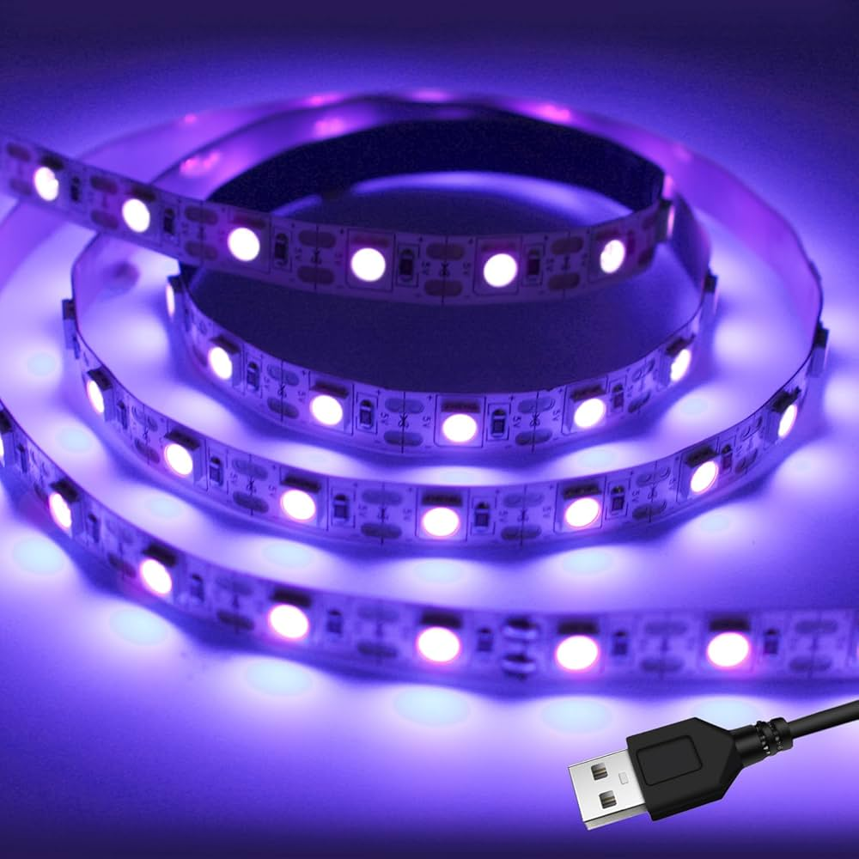
components
1.Ardino Uno
2. UV LED strip
3. Relay module
4. IR sensors
5. Limit switch
6. Power supply
7. DHT 11 sensor

Slide 5

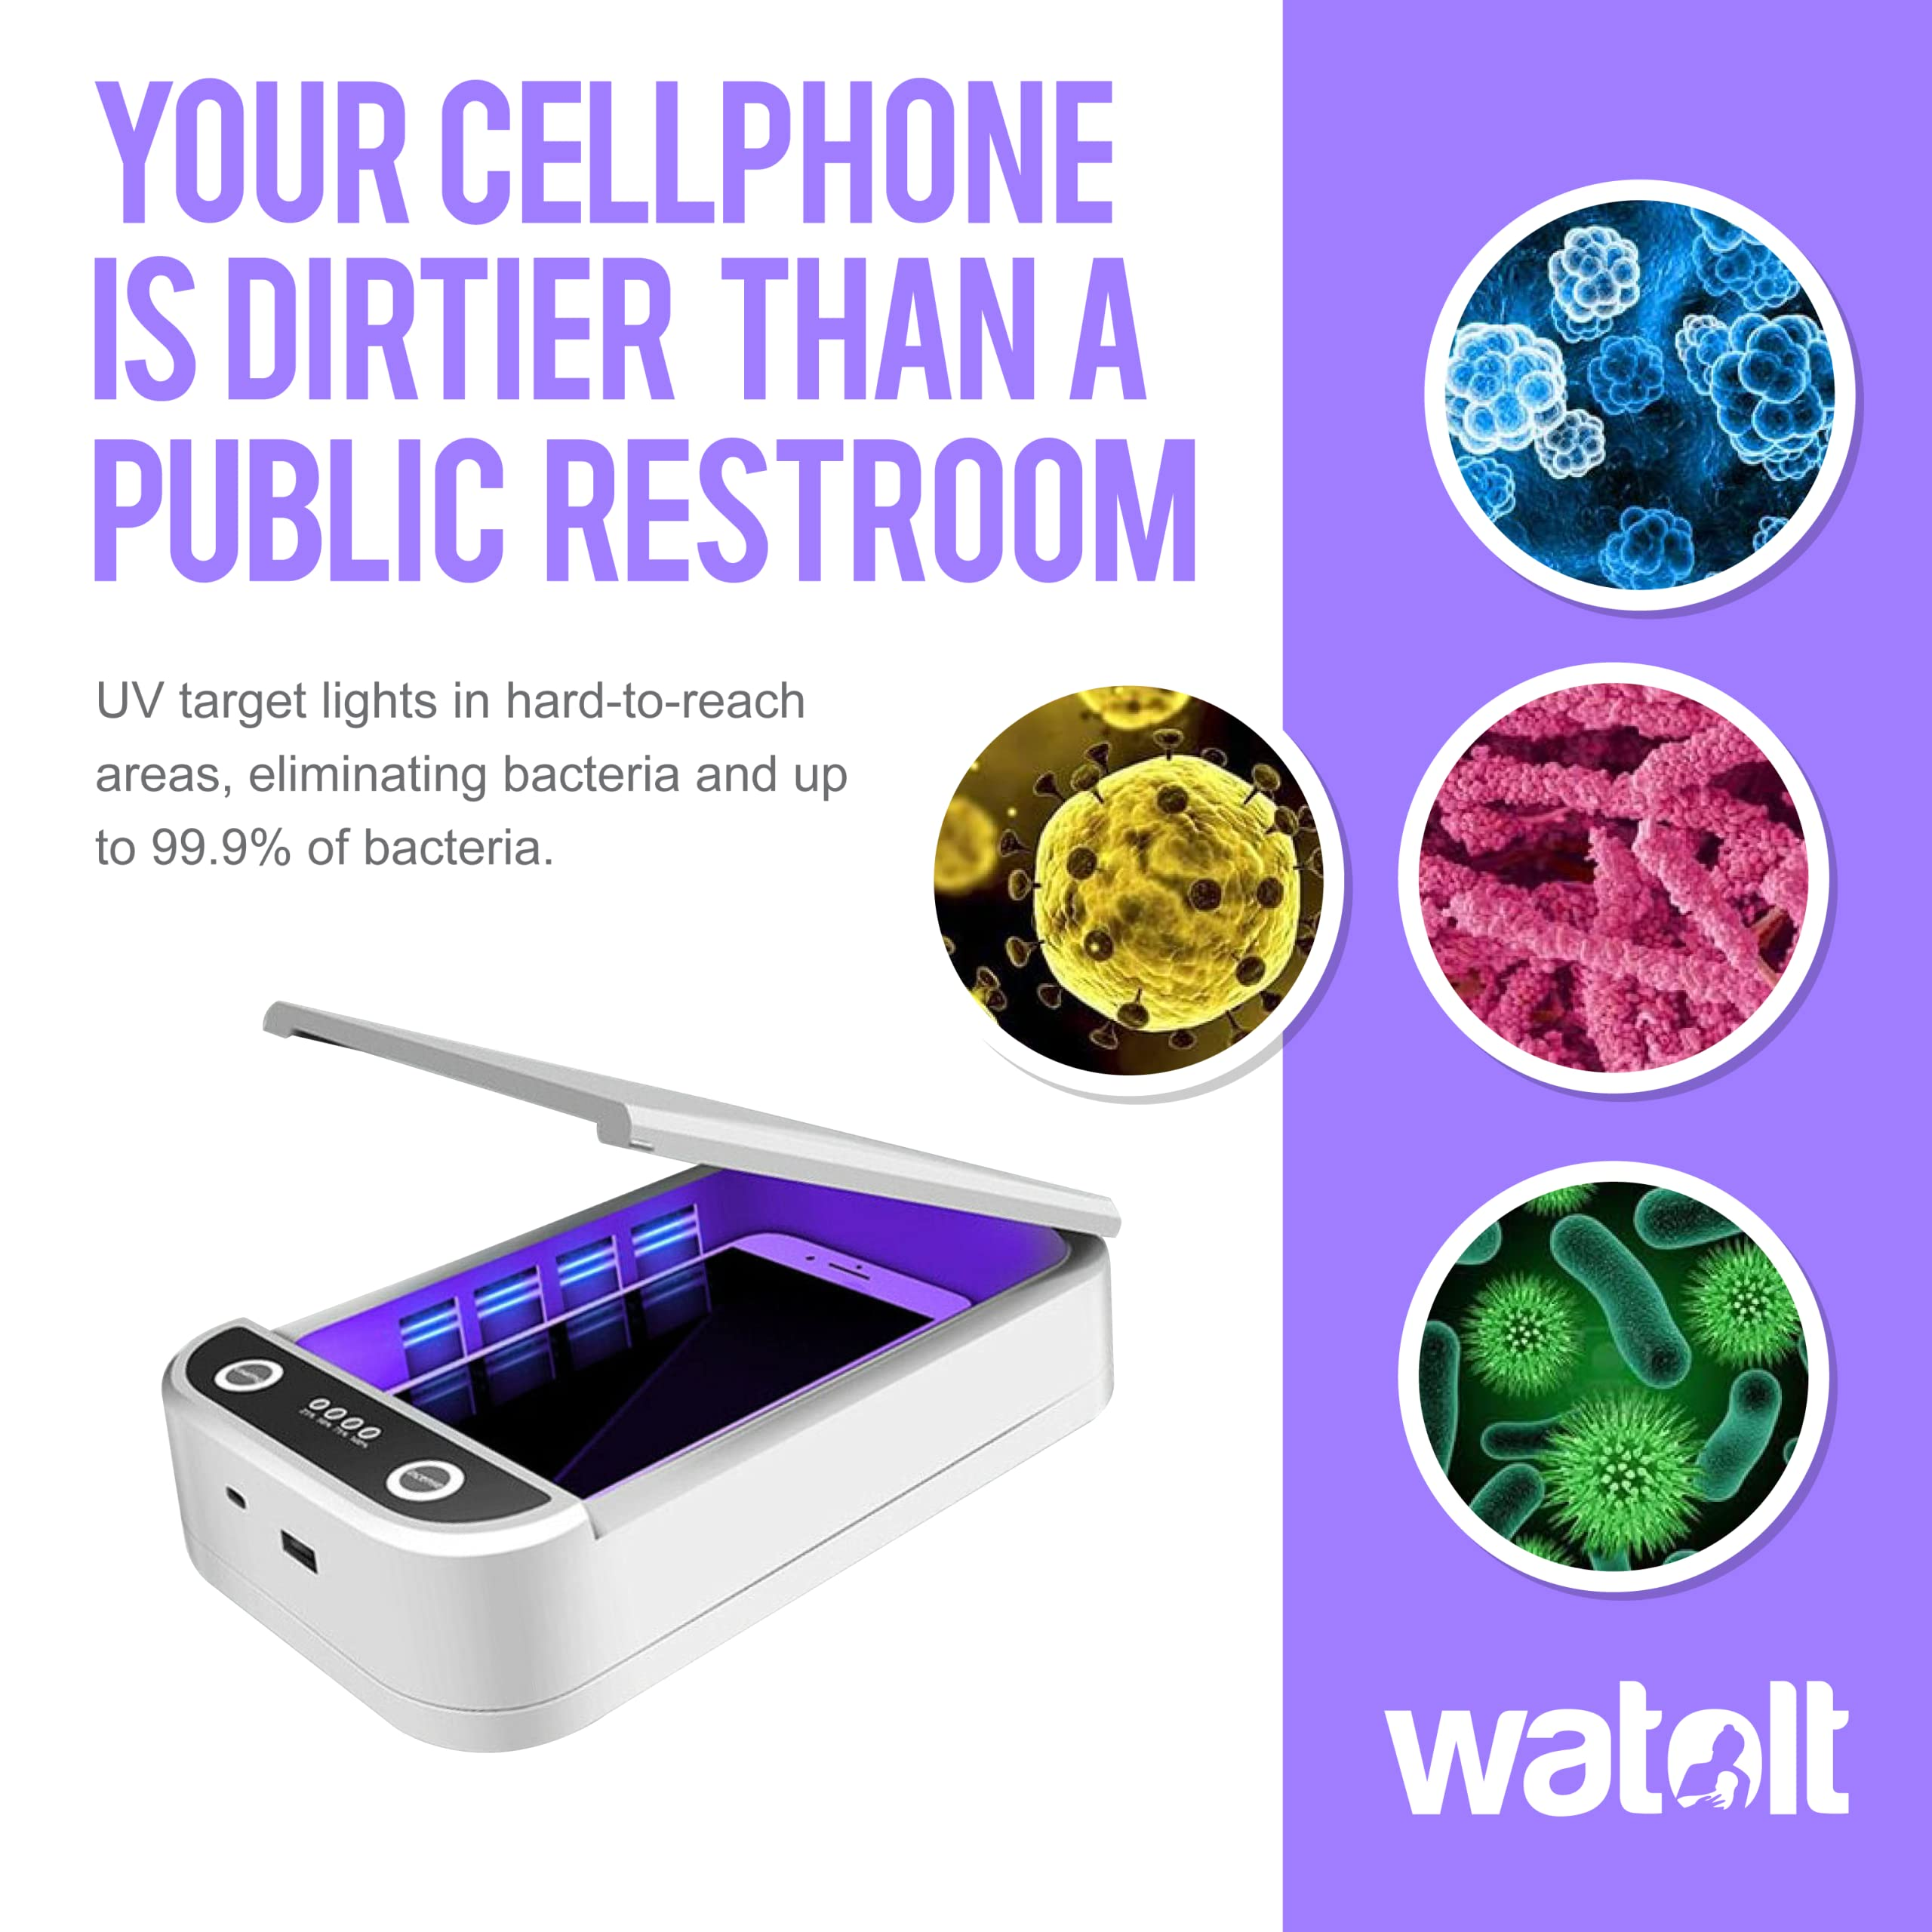
Working principle
1. Phones placed inside the box
2. Sensors check safety conditions
3. UV light turns on
4. Runs for a fixed time
5. Turns off automatically

Slide 6
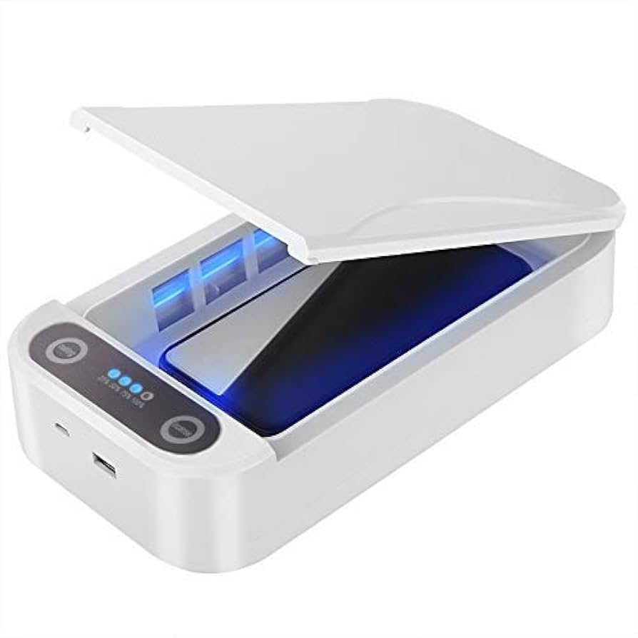
Advantages
Fast and automatic
Chemical-free cleaning
Safe for electronics
Applications
Homes
Hospitals
offices

Slide 7
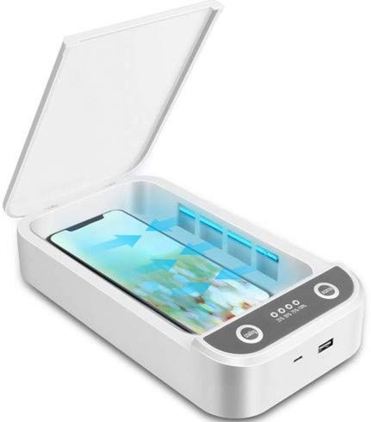
CONCLUSION
UV sterilisation is effective
Project ensures safe operation
Useful for daily hygiene

Slide 8
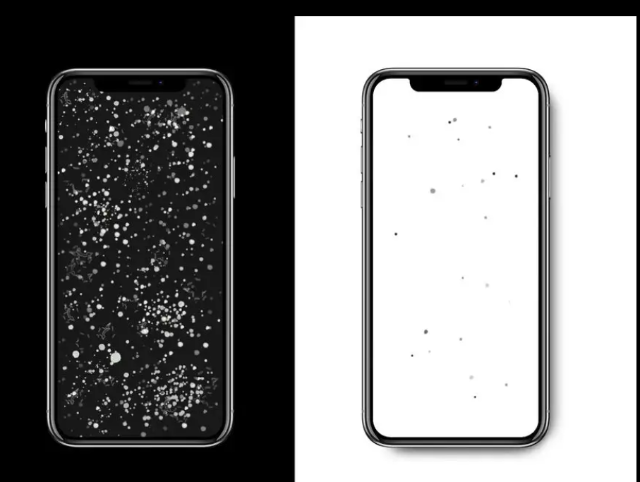
THANK YOU

